Slide 1
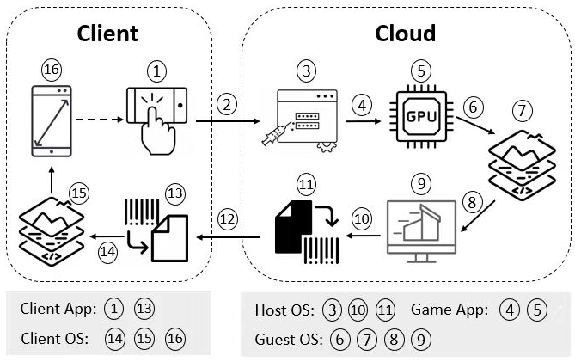
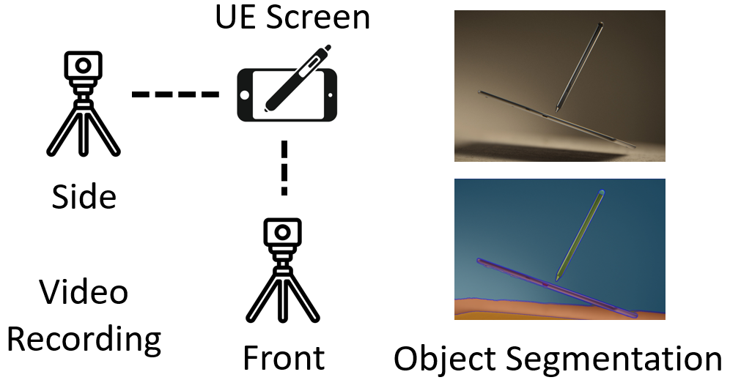
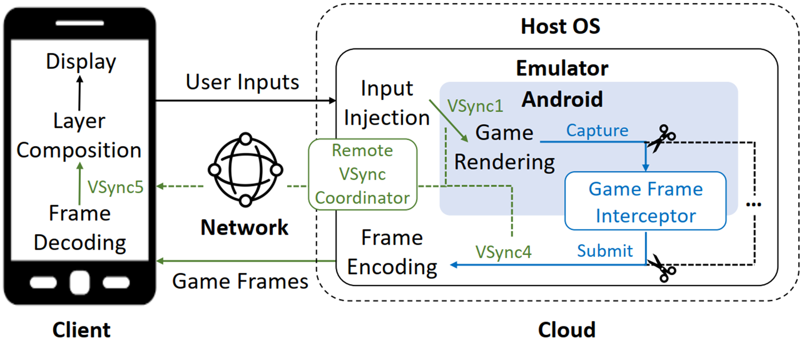
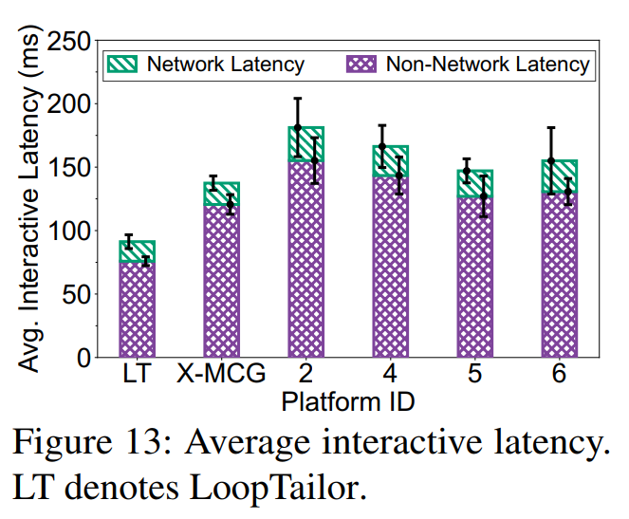
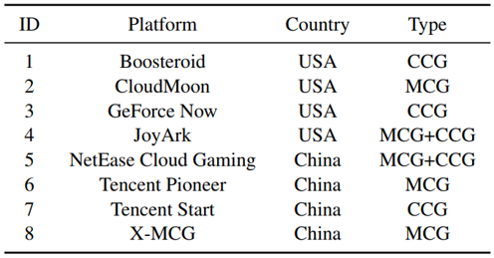
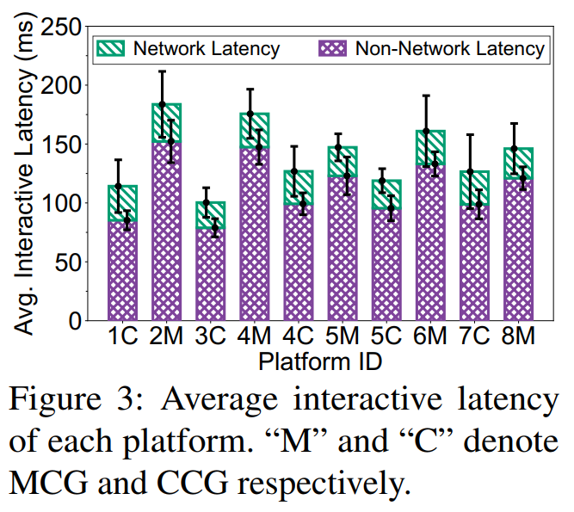
Dissecting and Streamlining the Interactive Loop of Mobile Cloud Gaming
Yang Li, Jiaxing Qiu, Hongyi Wang, Zhenhua Li, Feng Qian, Jing Yang, Hao Lin, Yunhao Liu, Bo Xiao, Xiaokang Qin, Tianyin Xu
How to measure interactive latencies of commercial Cloud Gaming platforms at scale? —— Record and Recognize
User Input Capture
User Input Transmission
User Input Injection
VSync1
Game Frame Rendering
VSync2
Cloud-side Layer Composition
VSync3
Virtual Display
VSync4
Game Frame Encoding
Game Frame Transmission
Game Frame Decoding
VSync5
Client-side Layer Composition
Client Display
Key Insight: VSync is the biggest latency contributor!
LoopTailor: Cropping the cloud-side graphics pipeline and stitching it to the client in a fine-grained manner
Network latency is not the key performance bottleneck of MCG’s performance!
Stable sub-100 ms interactive latency
Interactive Latency: 33.6-50.7% lower
Non-network latency: 37.1-51.1% lower

